Slide 1
UMET9U-30-1- Professional Skills for Banking and Finance Lecture 23
Presented by
Reinhold Heinlein
April 2026

Slide 2
Lecture content
Regression inference
Standard errors
Significance test for regression coefficients (t test)

Slide 3
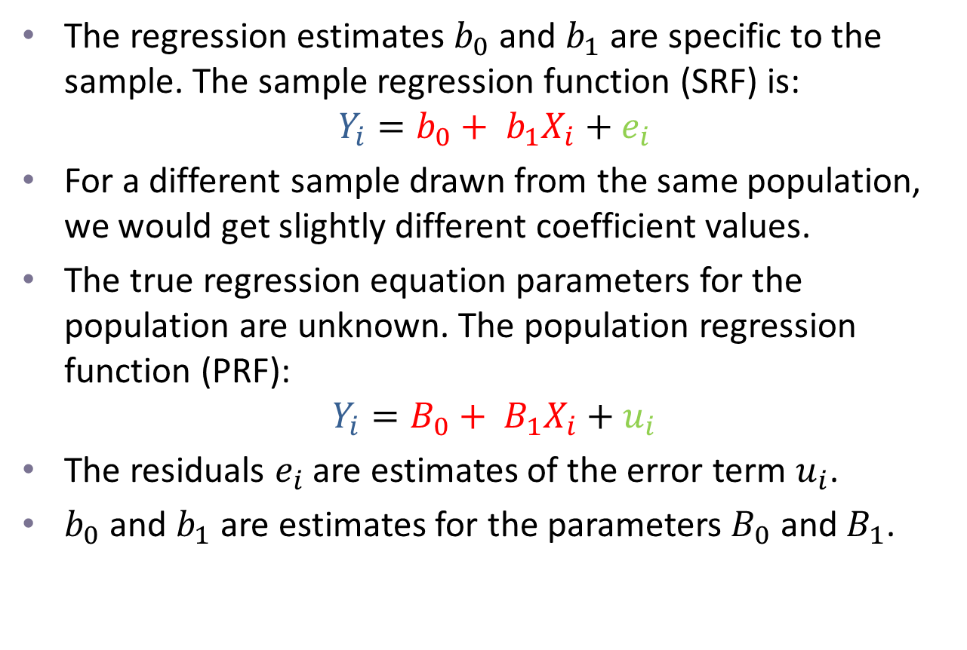
Regression analysis
The regression estimates $b_{0}$ and $b_{1}$ are specific to the sample. The sample regression function (SRF) is:
$$Y_{i}=b_{0}+ b_{1}X_{i}+e_{i}$$
For a different sample drawn from the same population, we would get slightly different coefficient values.
The true regression equation parameters for the population are unknown. The population regression function (PRF):
$$Y_{i}=B_{0}+ B_{1}X_{i}+u_{i}$$
The residuals $e_{i}$ are estimates of the error term $u_{i}$.
$b_{0}$ and $b_{1}$ are estimates for the parameters $B_{0}$ and $B_{1}$.

Slide 4
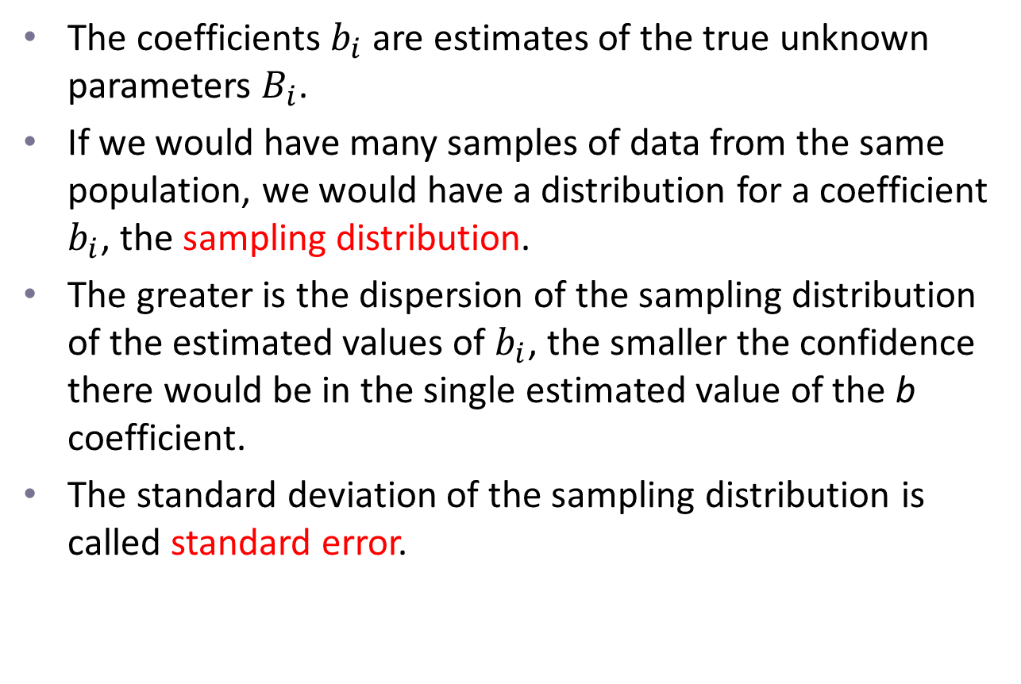
Precision and standard errors
The coefficients $b_{i}$ are estimates of the true unknown parameters $B_{i}$.
If we would have many samples of data from the same population, we would have a distribution for a coefficient $b_{i}$, the sampling distribution.
The greater is the dispersion of the sampling distribution of the estimated values of $b_{i}$, the smaller the confidence there would be in the single estimated value of the b coefficient.
The standard deviation of the sampling distribution is called standard error.

Slide 5
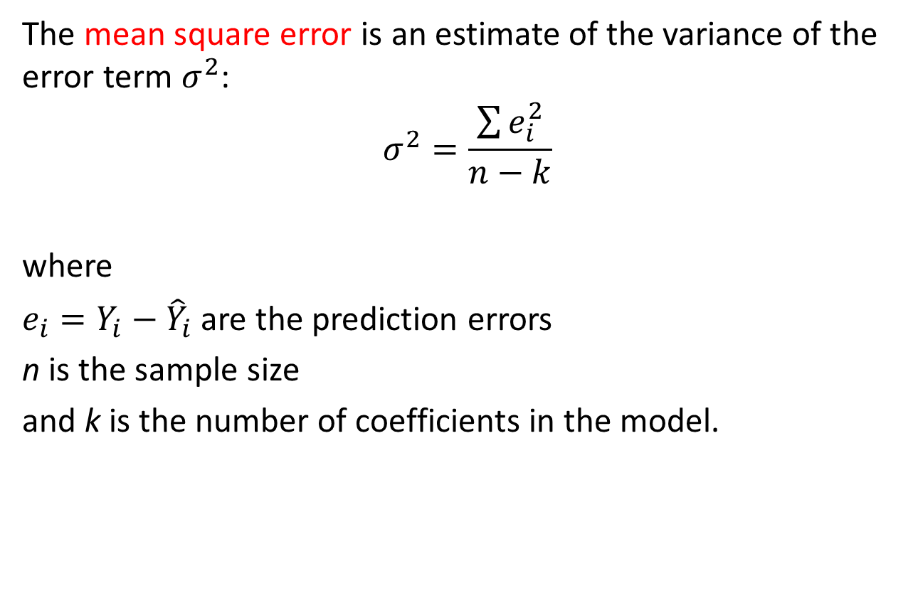
Estimating the variance of the error term
The mean square error is an estimate of the variance of the error term $σ^{2}$:
$$σ^{2}=\frac{\sum{e_{i}^{2}}}{n−k}$$
where
$e_{i}=Y_{i}−{\hat{Y}}_{i}$ are the prediction errors
n is the sample size
and k is the number of coefficients in the model.

Slide 6
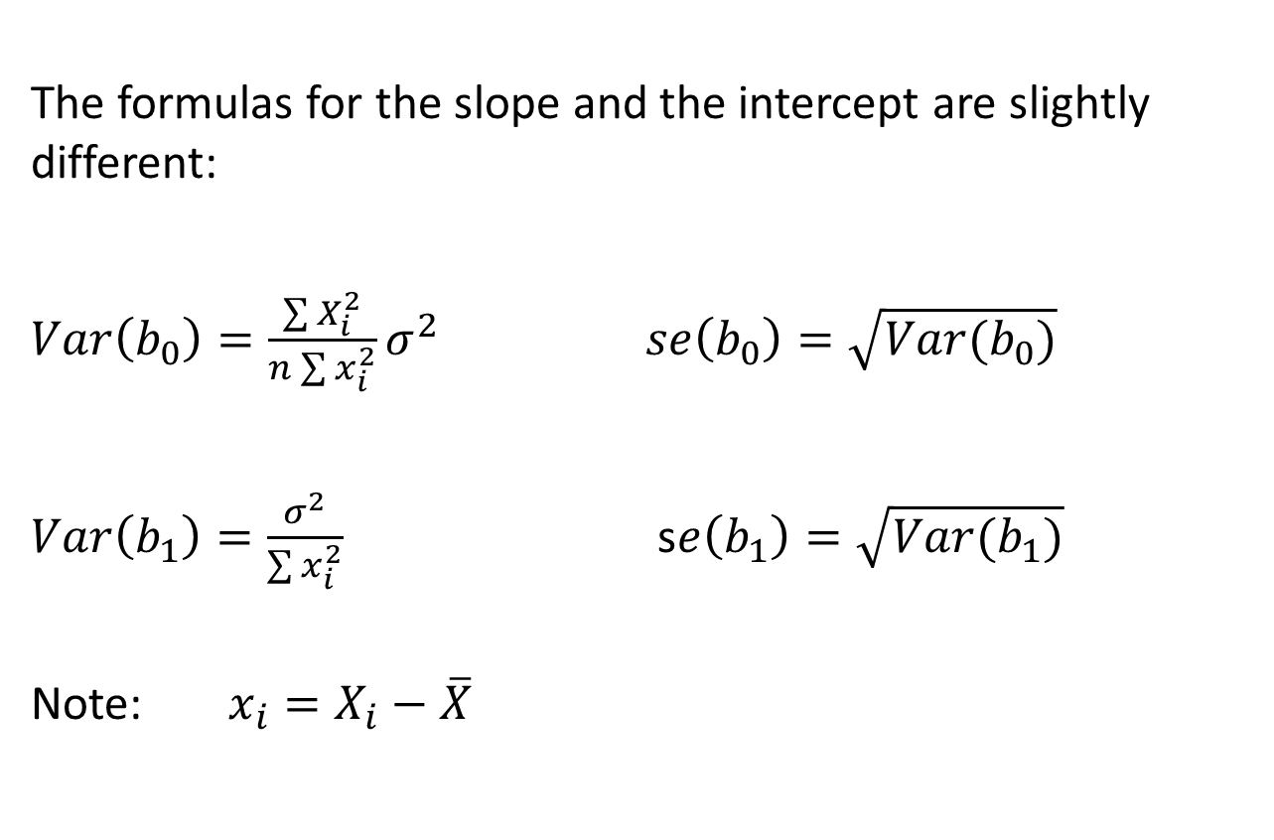
Computing the standard errors of the coefficients
The formulas for the slope and the intercept are slightly different:
$Var\left(b_{0}\right)=\frac{\sum{X_{i}^{2}}}{n\sum{x_{i}^{2}}}σ^{2}$ $se\left(b_{0}\right)=\sqrt{Var(b_{0})}$
$Var\left(b_{1}\right)=\frac{σ^{2}}{\sum{x_{i}^{2}}}$ s$e\left(b_{1}\right)=\sqrt{Var(b_{1})}$
Note: $x_{i}=X_{i}−\overline{X}$

Slide 7
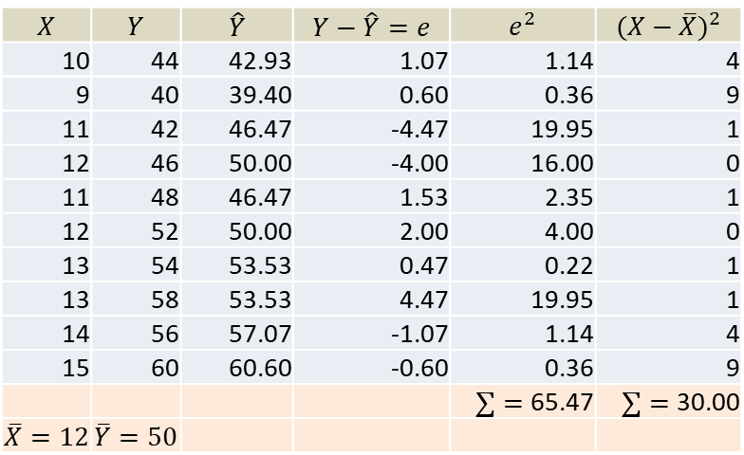

Standard error for slope coefficient in the advertisement-sales example lecture 21
$$se\left(b_{1}\right)=\sqrt{\frac{\sum{e_{t}^{2}}}{(n−k)\sum{{\left(X_{t}−\overline{X}\right)}^{2}}}}=\sqrt{\frac{65.47}{\left(10−2\right)∗30 }}=0.52$$
$$X$$ | $$Y$$ | $$\hat{Y}$$ | $$Y−\hat{Y}=e$$ | $$e^{2}$$ | $${(X−\overline{X})}^{2}$$
10 | 44 | 42.93 | 1.07 | 1.14 | 4
9 | 40 | 39.40 | 0.60 | 0.36 | 9
11 | 42 | 46.47 | -4.47 | 19.95 | 1
12 | 46 | 50.00 | -4.00 | 16.00 | 0
11 | 48 | 46.47 | 1.53 | 2.35 | 1
12 | 52 | 50.00 | 2.00 | 4.00 | 0
13 | 54 | 53.53 | 0.47 | 0.22 | 1
13 | 58 | 53.53 | 4.47 | 19.95 | 1
14 | 56 | 57.07 | -1.07 | 1.14 | 4
15 | 60 | 60.60 | -0.60 | 0.36 | 9
 |  |  |  | $∑=$ 65.47 | $∑=$ 30.00
$$\overline{X}=12$$ | $$\overline{Y}=50$$

Slide 8
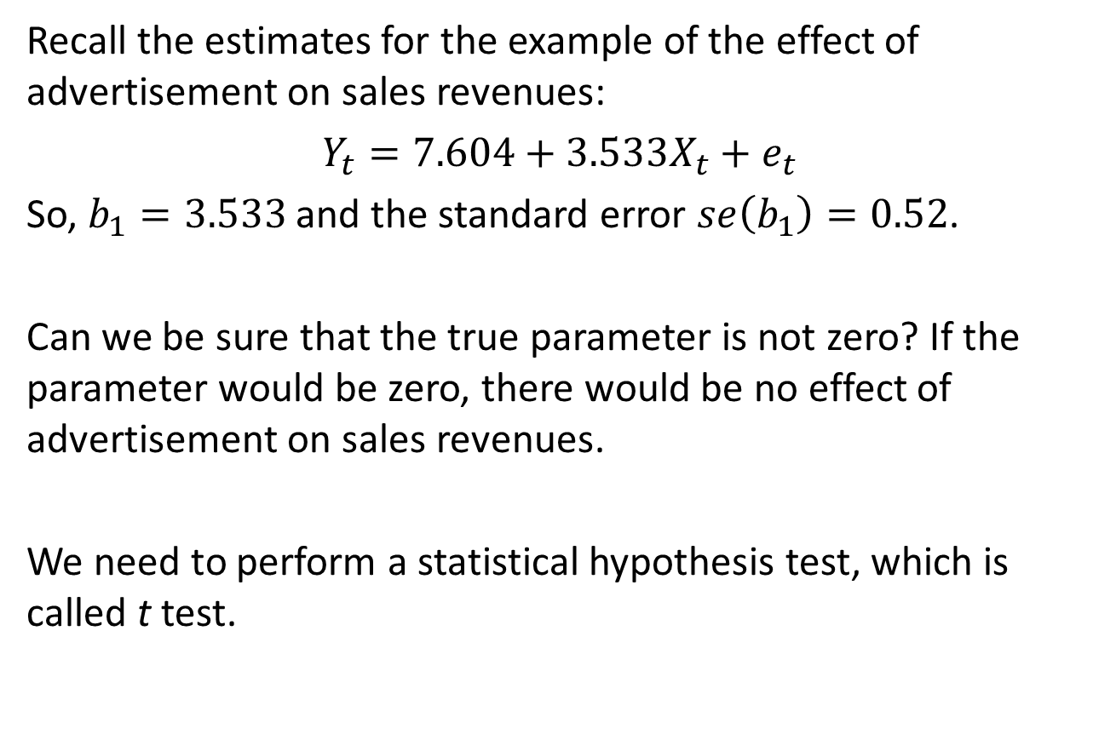
Significance test of individual coefficient
Recall the estimates for the example of the effect of advertisement on sales revenues:
$Y_{t}=7.604+3.533X_{t}+e_{t}$
So, $b_{1}=3.533$ and the standard error $se\left(b_{1}\right)=0.52$.
Can we be sure that the true parameter is not zero? If the parameter would be zero, there would be no effect of advertisement on sales revenues.
We need to perform a statistical hypothesis test, which is called t test.

Slide 9
Conducting a test of significance
As a t test is a hypothesis test, it follows the usual steps of a hypothesis test.
Write down what you are testing: Null and alternative hypothesis.
Compute a test statistic from the sample data.
Look up a critical value in a statistical table.
Decision: Reject or not reject the null.
Conclusion: What can be learned from the test.

Slide 10
Conducting a test of significance
A t test is focussing on one coefficient at a time; it can be a slope coefficient or the intercept.
A t test can be one-sided or two-sided depending on the question.
We start with a two-sided test. Is the slope coefficient statistically significant? Meaning: Can we sure that it is not zero.

Slide 11
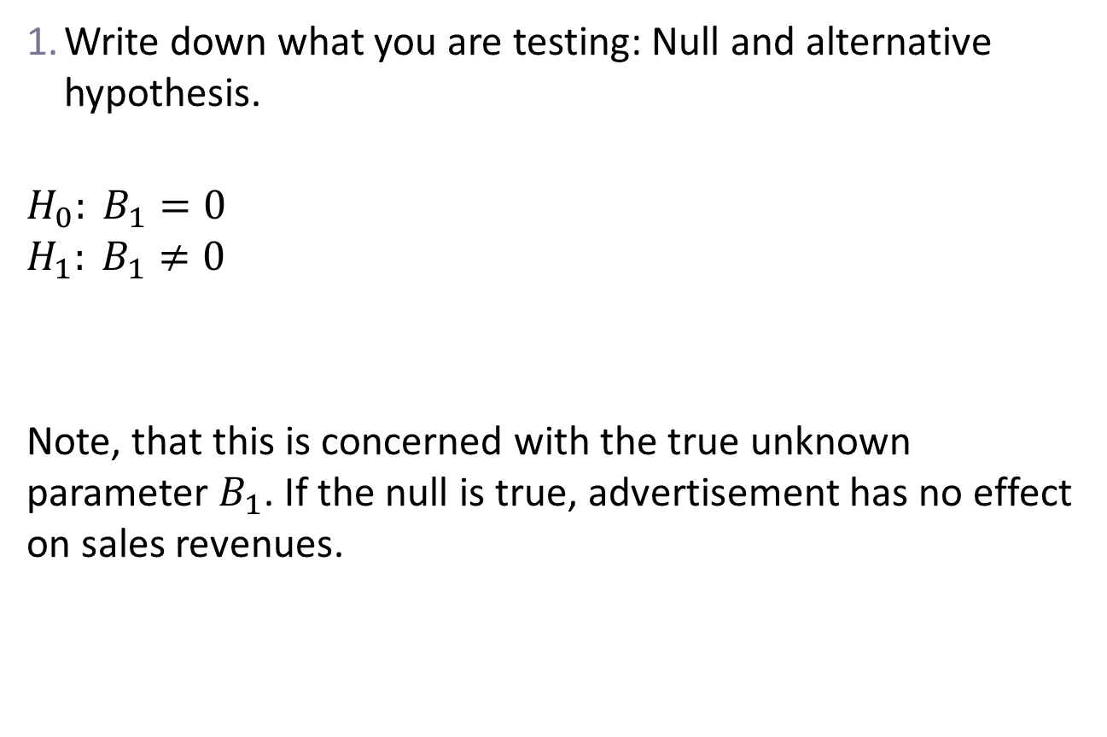
t test: two-sided, for the slope, relative to 0.
Write down what you are testing: Null and alternative hypothesis.
$$H_{0}: B_{1}=0$$
$$H_{1}: B_{1}≠0$$
Note, that this is concerned with the true unknown parameter $B_{1}$. If the null is true, advertisement has no effect on sales revenues.

Slide 12
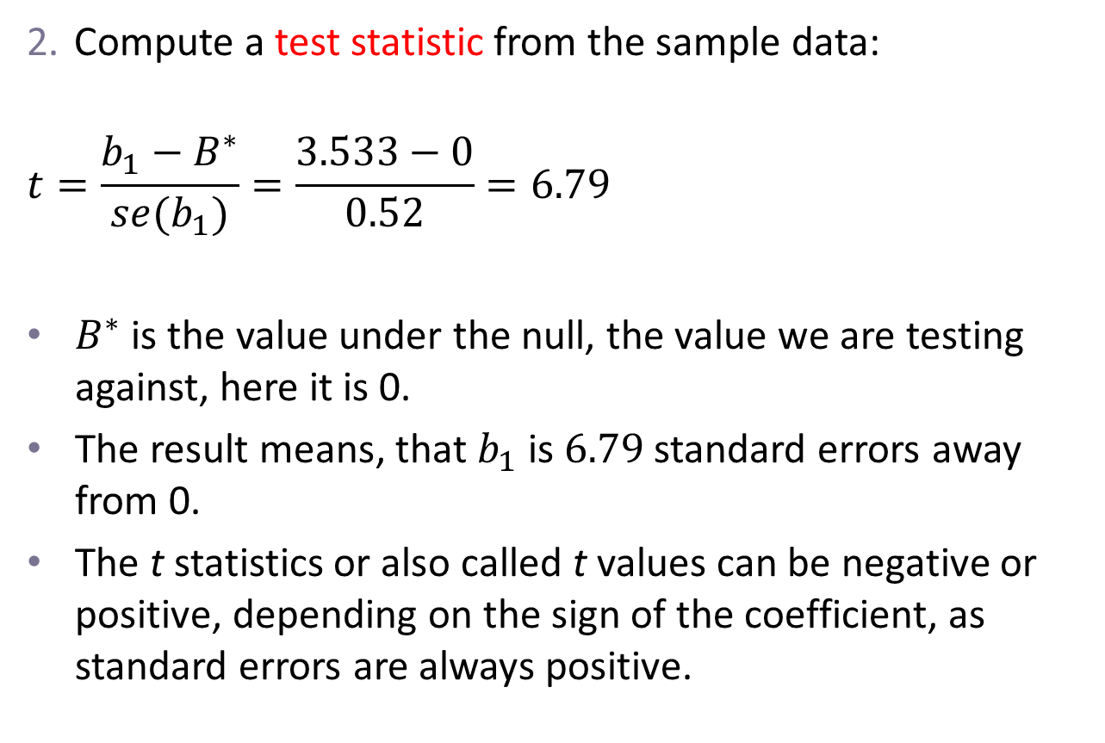
t test: two-sided, for the slope, relative to 0.
Compute a test statistic from the sample data:
$$t=\frac{b_{1}−B^{∗}}{se(b_{1})}=\frac{3.533−0}{0.52}=6.79$$
$B^{∗}$ is the value under the null, the value we are testing against, here it is 0.
The result means, that $b_{1}$ is $6.79$ standard errors away from 0.
The t statistics or also called t values can be negative or positive, depending on the sign of the coefficient, as standard errors are always positive.

Slide 13
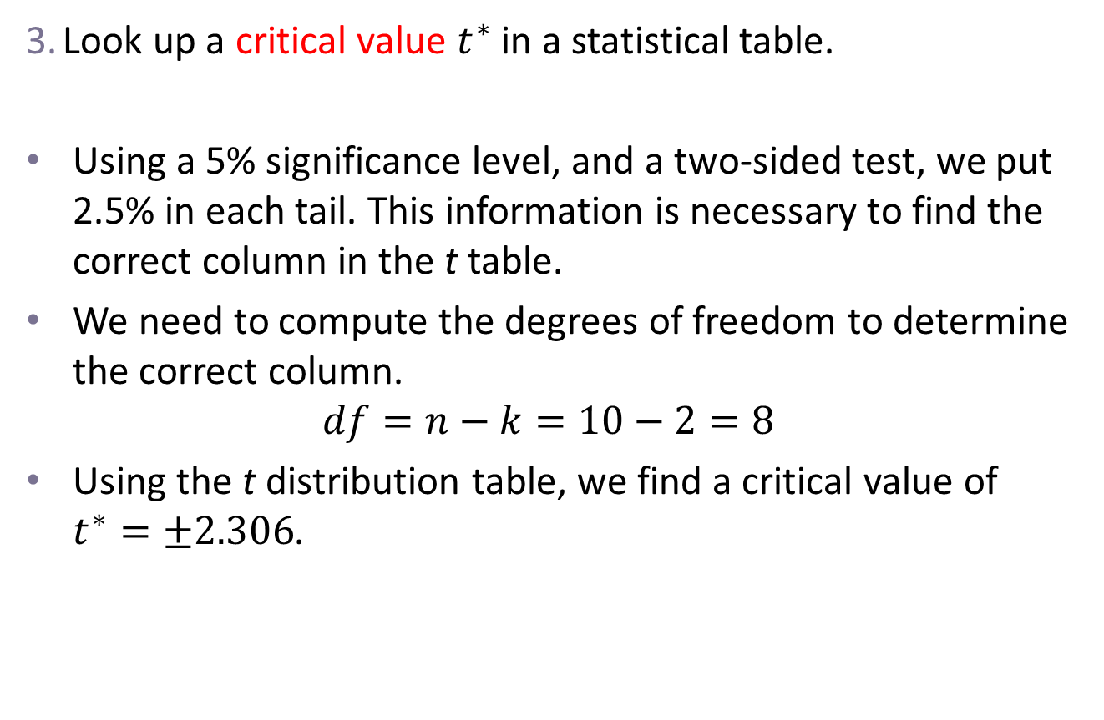
t test: two-sided, for the slope, relative to 0.
Look up a critical value $t^{∗}$ in a statistical table.
Using a 5% significance level, and a two-sided test, we put 2.5% in each tail. This information is necessary to find the correct column in the t table.
We need to compute the degrees of freedom to determine the correct column.
$$df=n−k=10−2=8$$
Using the t distribution table, we find a critical value of $t^{∗}=±2.306$.

Slide 14
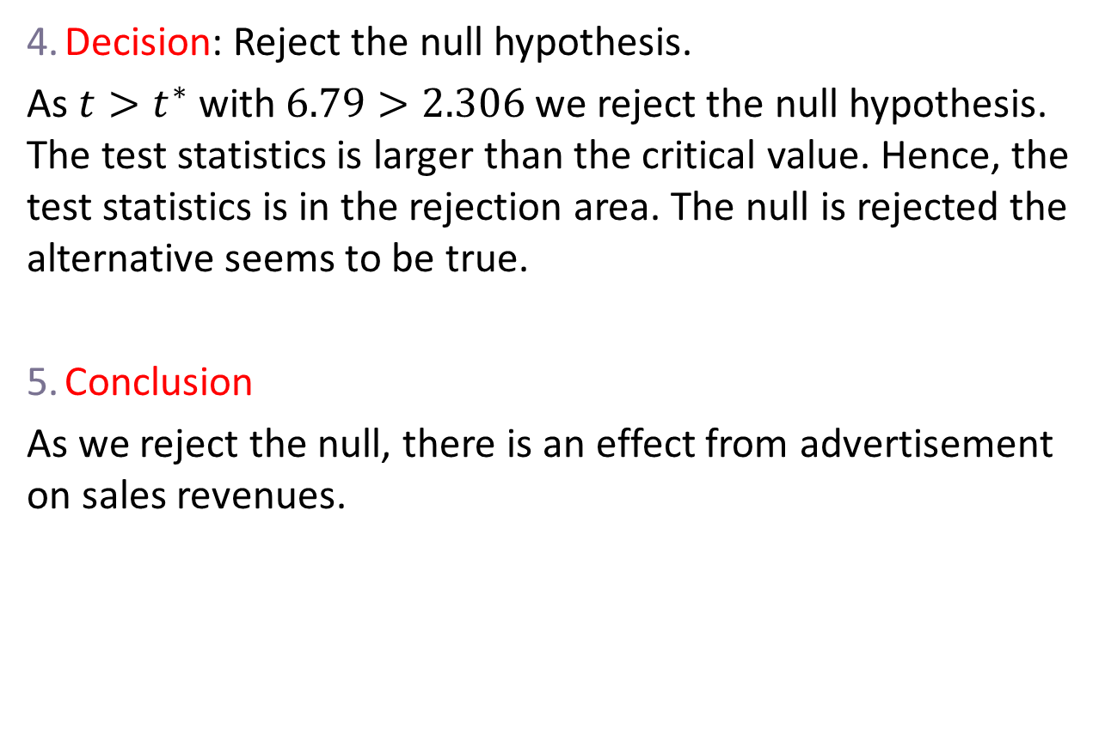
t test: two-sided, for the slope, relative to 0.
Decision: Reject the null hypothesis.
As $t>t^{∗}$ with $6.79>2.306$ we reject the null hypothesis. The test statistics is larger than the critical value. Hence, the test statistics is in the rejection area. The null is rejected the alternative seems to be true.
Conclusion
As we reject the null, there is an effect from advertisement on sales revenues.

Slide 15
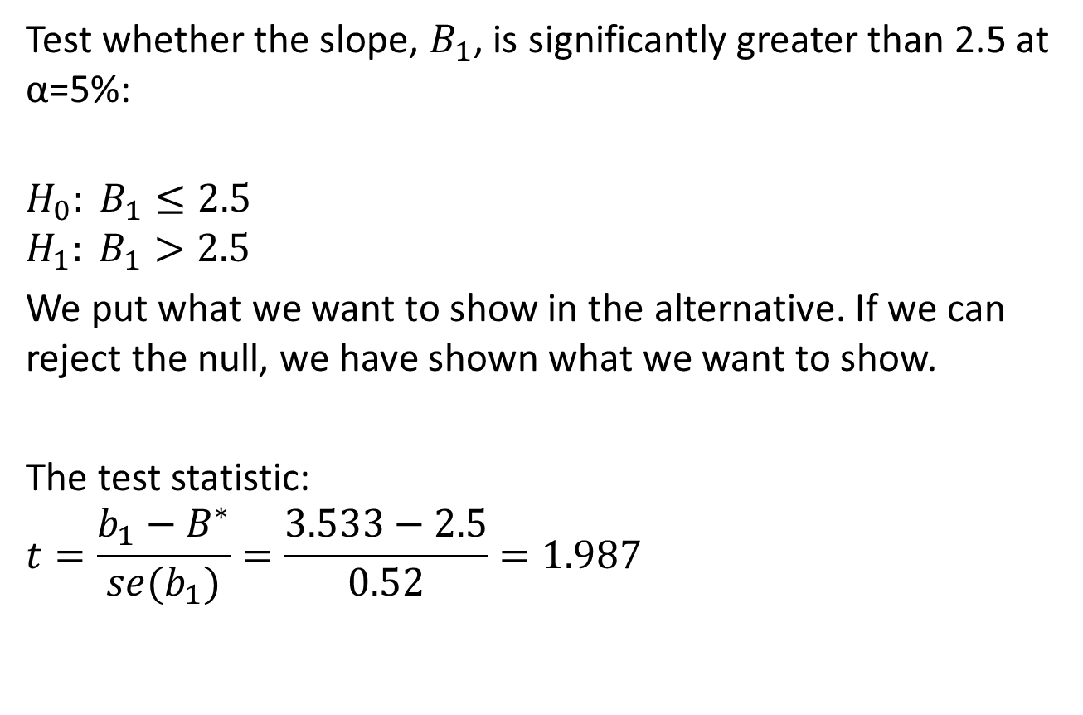
Conducting a one-sided t test
Test whether the slope, $B_{1}$, is significantly greater than 2.5 at α=5%:
$$H_{0}: B_{1}≤2.5$$
$$H_{1}: B_{1}>2.5$$
We put what we want to show in the alternative. If we can reject the null, we have shown what we want to show.
The test statistic:
$$t=\frac{b_{1}−B^{∗}}{se(b_{1})}=\frac{3.533−2.5}{0.52}=1.987$$

Slide 16
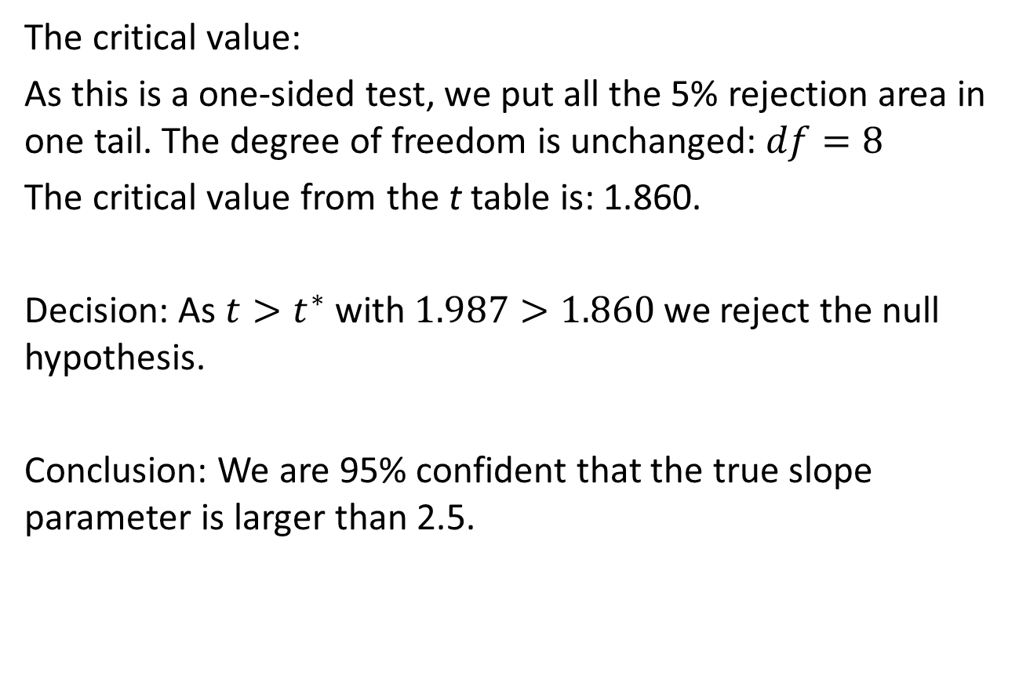
Conducting a one-sided t test continues
The critical value:
As this is a one-sided test, we put all the 5% rejection area in one tail. The degree of freedom is unchanged: $df=8$
The critical value from the t table is: 1.860.
Decision: As $t>t^{∗}$ with $1.987>1.860$ we reject the null hypothesis.
Conclusion: We are 95% confident that the true slope parameter is larger than 2.5.

Slide 17

Next Lecture
Regression inference
Coefficient of determination $R^{2}$
Overall significance of a model: F test

